Slide 1
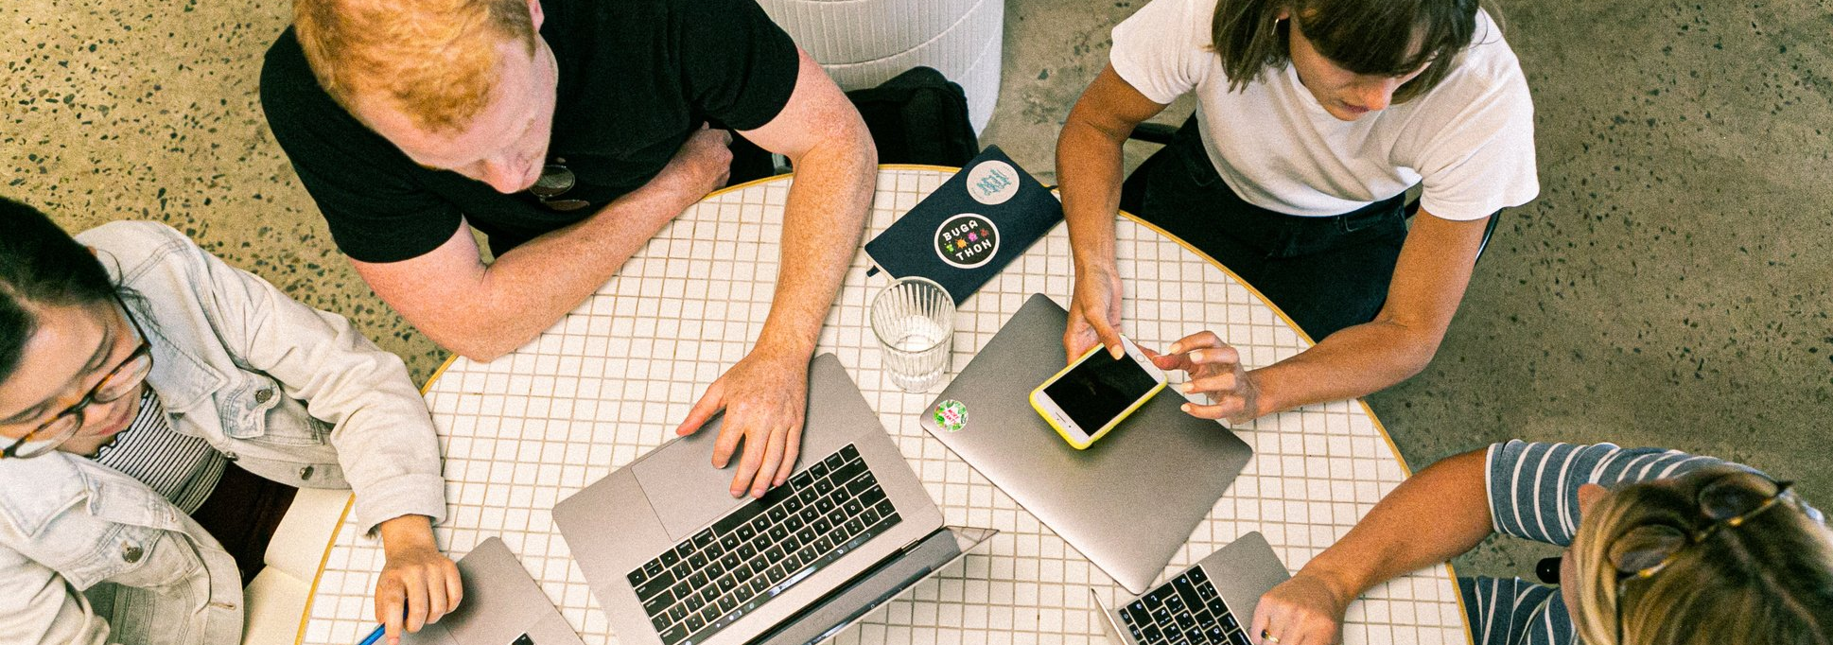



Scrum Acers
Group 7 (Dev Team)
Guryash Singh Dhall B00910690
Sukaran Golani B00893693
Aditya Satendra Dixit B00874076
Parvish Vijay Gajjar B00912090
Farhin Damania B00871338
CSCI 5308
Professor - Dr. Tushar Sharma
TA - Suman Singh
Group 2 (Client Team)

Slide 2
Project Objectives
Increase Dev productivity by decreasing time spent in project management tasks
Mitigate Daily Stand-up meetings
Provide a platform for team members to vote/provide feedback for current and future scrums anonymously
Provide a platform for company-wide / project-wide announcements
Recognize efficient team-work and great intra-team collaborations by giving out badges to well deserving employees

Slide 3
Meeting Stats (Overall)
Meeting Type | Count
Client and TA | 10
TA | 11
Dev and TA’s | 11
Internal | 28

Slide 4
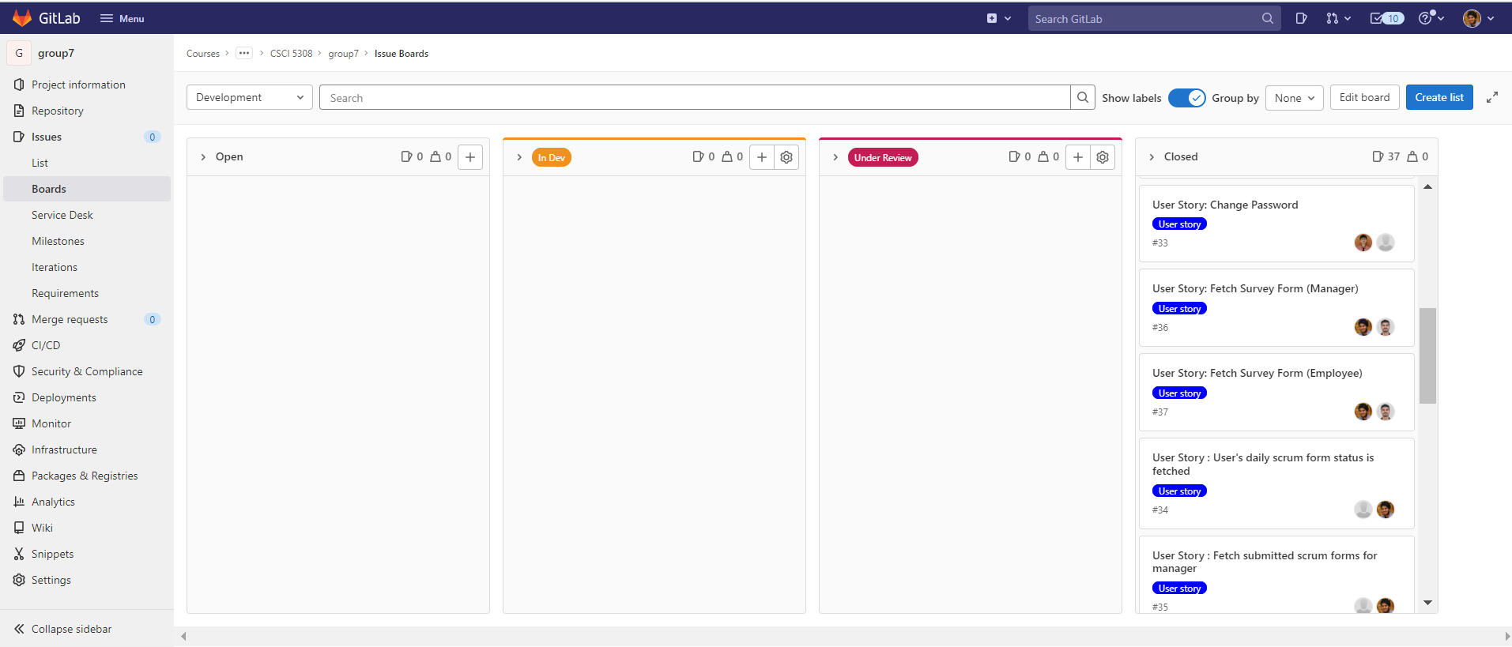
Board Progress (Overall)

Slide 5
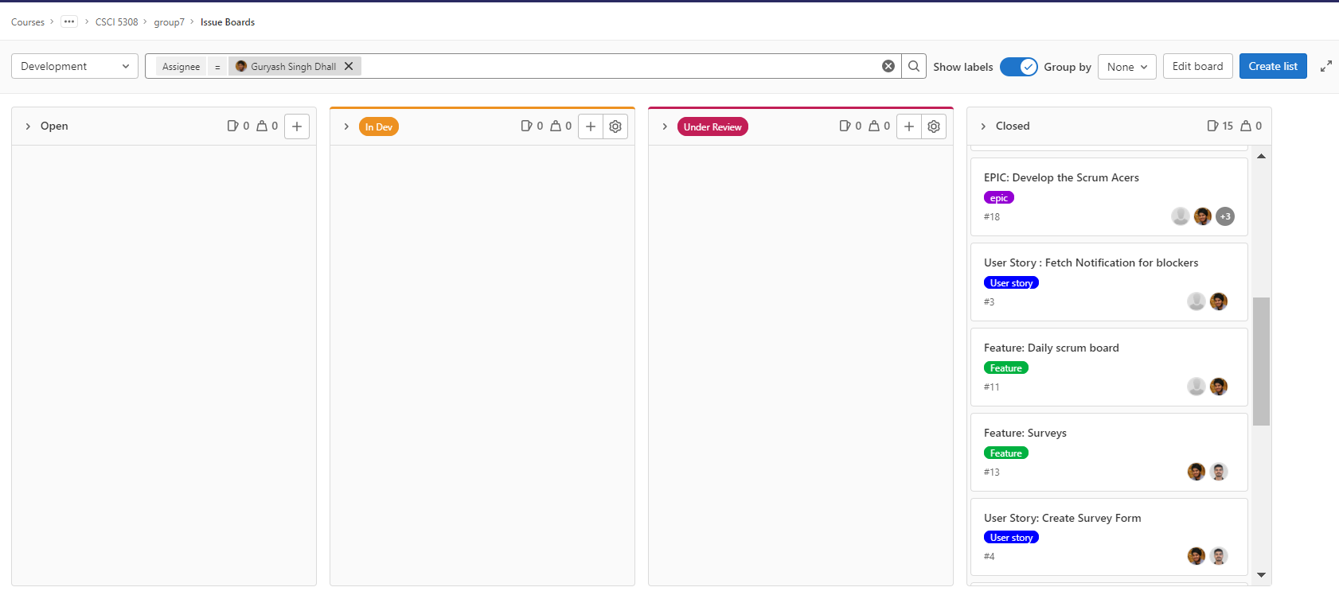
Board Progress (Guryash)
Number of user stories :- 15

Slide 6
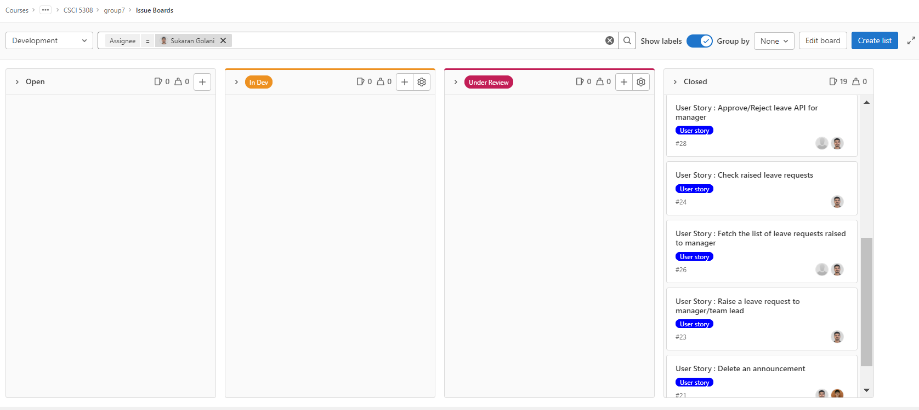
Board Progress (Sukaran)
Number of user stories :- 19

Slide 7
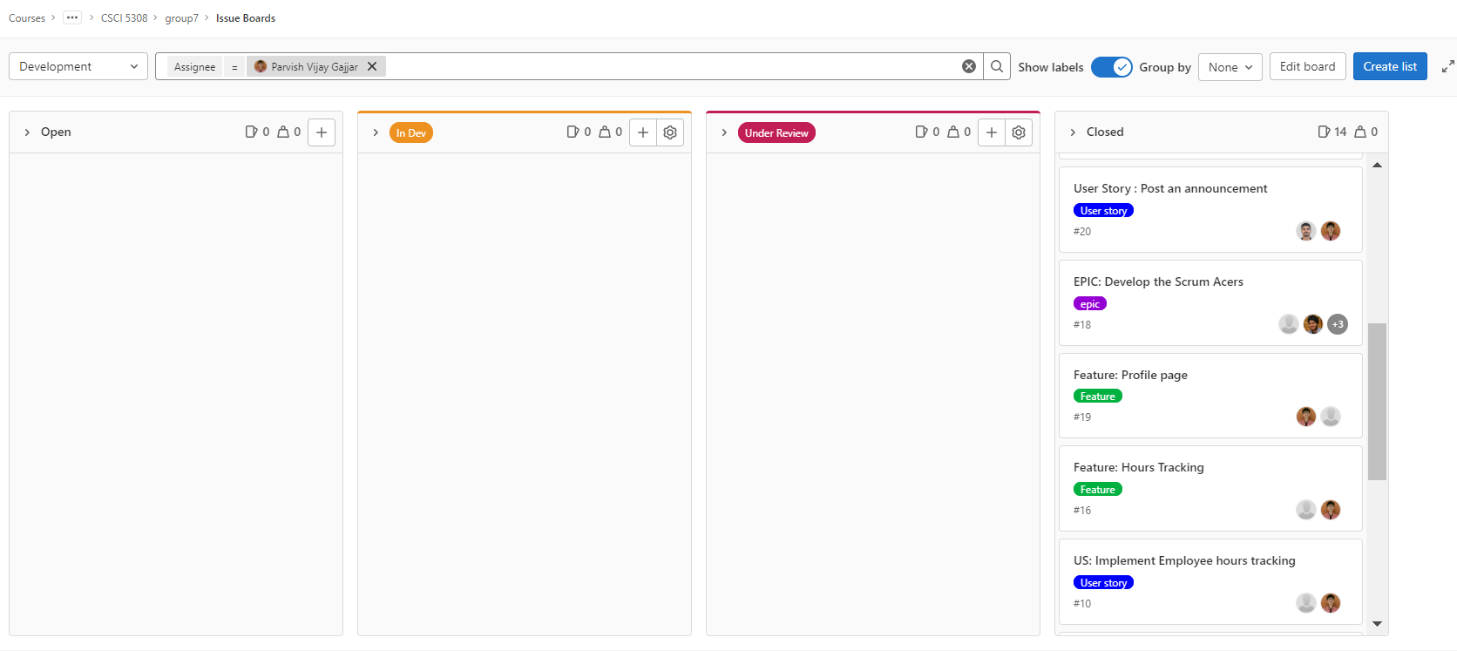
Board Progress (Parvish)
Number of user stories :- 14

Slide 8
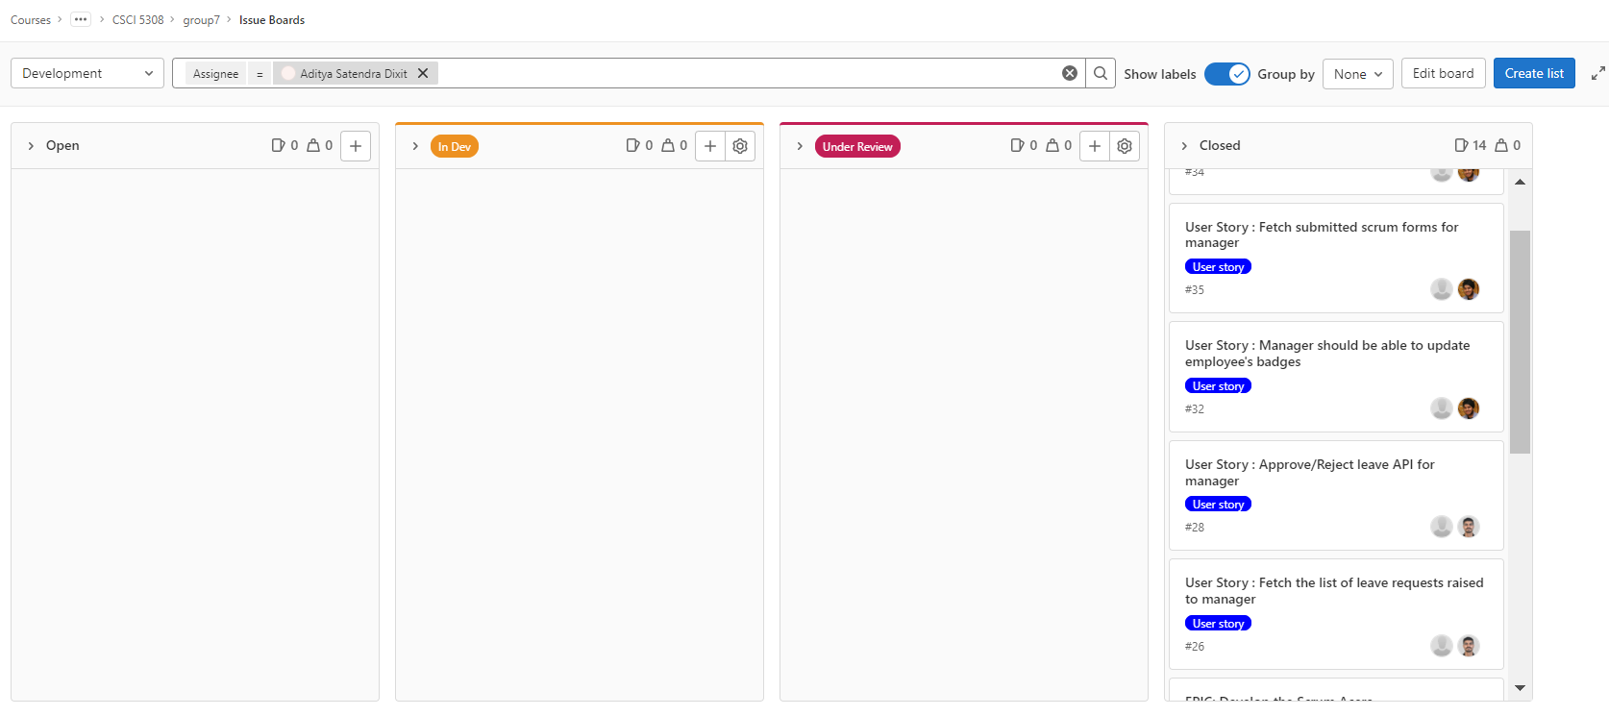
Board Progress (Aditya)
Number of user stories :- 14

Slide 9
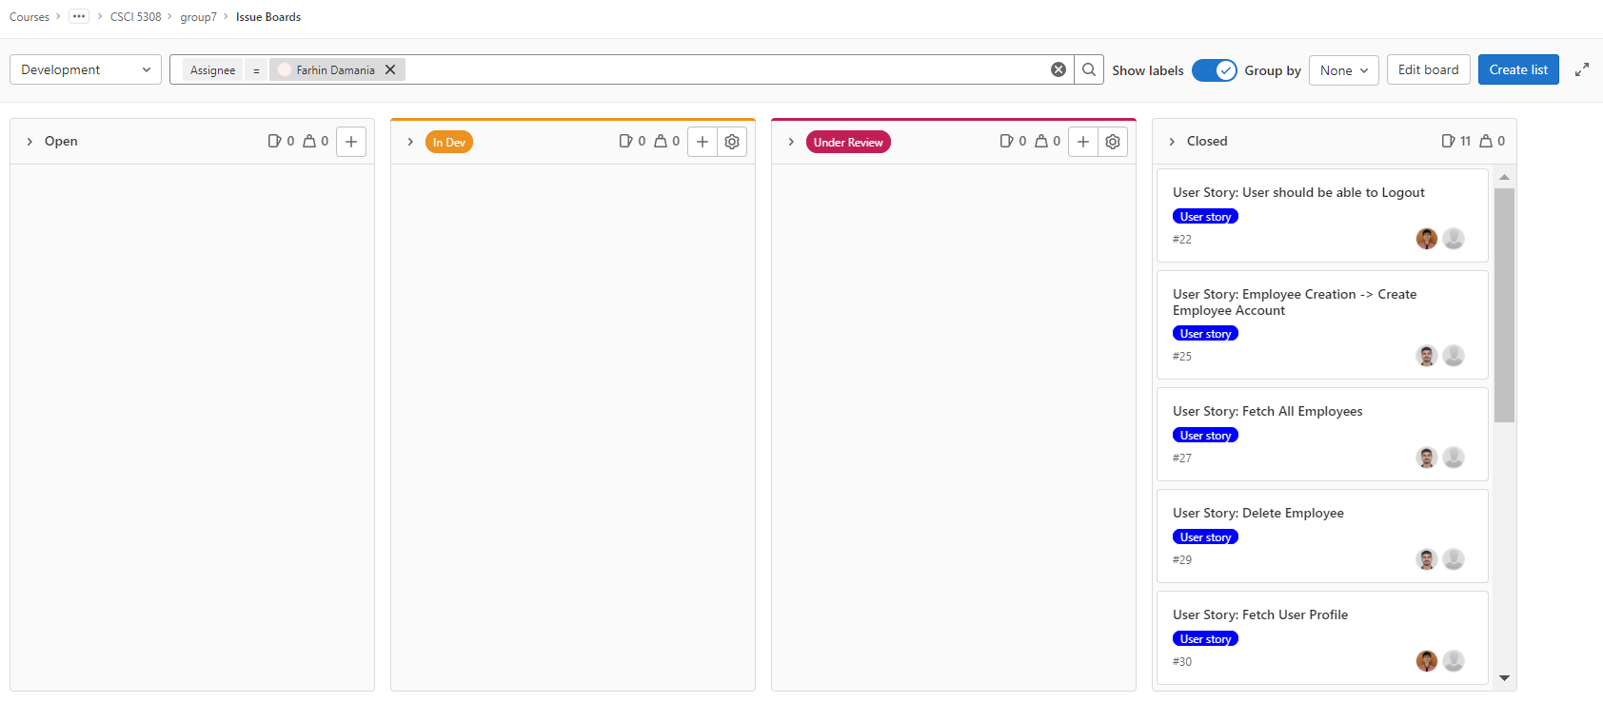
Board Progress (Farhin)
Number of user stories :- 11

Slide 10
Final Project Status
Milestones Achieved | Status
Login | Completed
Daily Scrum Forms | Completed
Leave Management | Completed
Badges | Completed
Survey Form | Completed
Announcement | Completed
Notification | Completed
Hours Tracking | Completed
User Password Management | Completed
Profile Creation/Deletion | Completed
Extra Milestones Achieved | Status
My Profile Module | Completed
Front End Test Cases | Completed

Slide 11
Learning from this Project
Understanding code smells and technical debt
Refactoring of code in order to remove duplications and smells (48 to 0)
Designing schema in order to avoid complex queries
Developing test cases in NodeJS to increase coverage from 45% to 83%
Learning new technologies and error and exception handling

Slide 12
Demo Time!!!
WebApp Link : https://scrum-acers-frontend.herokuapp.com/

Slide 13


Thank You !!
We are open for Q&A
Template Source

